Slide 1
Blended Learning in Software Engineering with SCORM 2004
15th workshop on “Software engineering education and reverse engineering”
Bohinj, Slovenia
25.08.2015
Asya Stoyanova-Doycheva, Emil Doychev, Stanimir Stoyanov

Slide 2
Development of e-content in SCORM 2004
Software Engineering e-textbook in SCORM2004
http://delc2.fmi.uni-plovdiv.net/

Slide 3
Concepts of SCORM
Creating of small and reusable components – SCOs:
they contain assets (text, picture, animation, diagram and so on);
are the smallest units that can communicate with and managed by the LMS
Organization of SCOs in bigger components named Aggregations
Defining sequencing and navigation between different components

Slide 4
Development process
1. Designing e-textbook in SCORM format;
2. Designing and realization of the e-textbook in SCORM editor;
3. Implementation of the control tests;
4. Testing the e-textbook in our SCORM player in DeLC

Slide 5
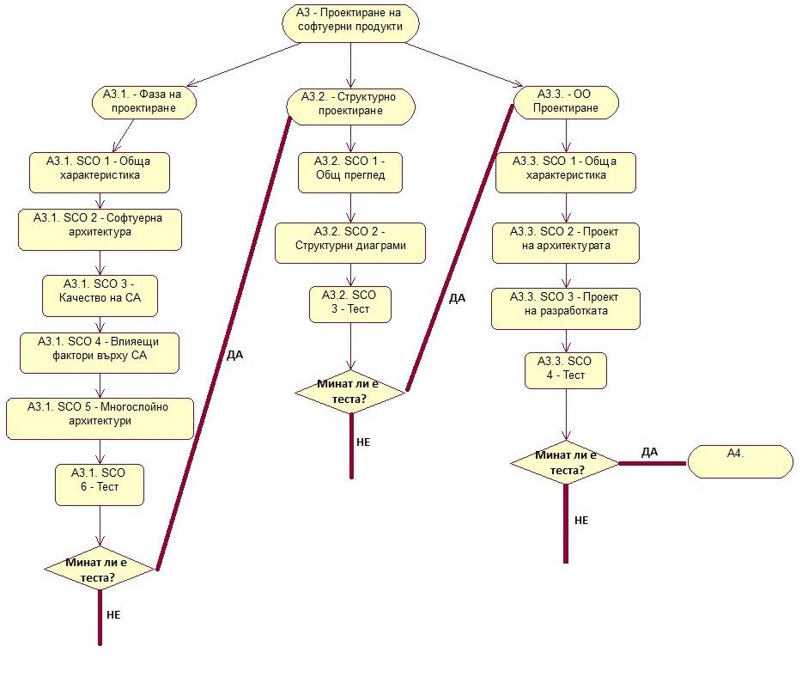
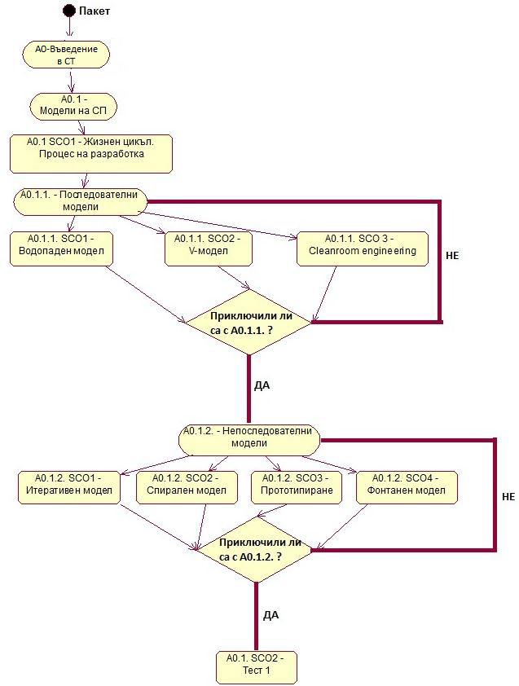
Structure of the SE e-textbook

Slide 6
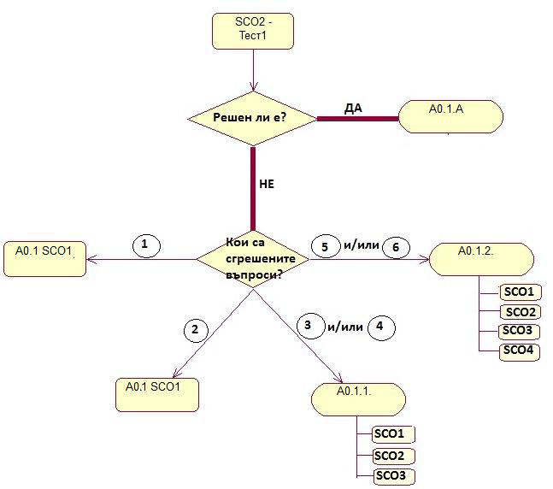
Navigation scheme

Slide 7
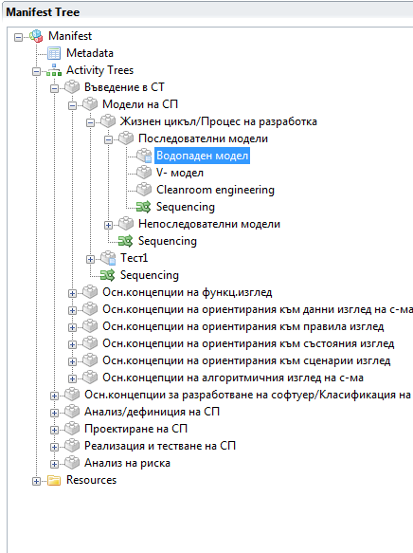
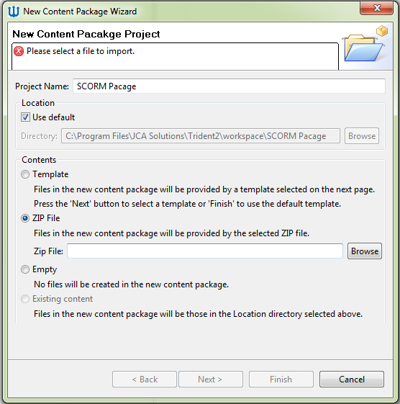
Design and realization of the e-textbook in SCORM editor
All e-learning components
Execution order of the components
All resource files associated with e-learning components

Slide 8
Implementation Tools
Trident IDE 2.0
HTML5, CSS3
XML
JavaScript, Bootstrap
DeLC SCORM Player

Slide 9
E-textbook in SE

Slide 10
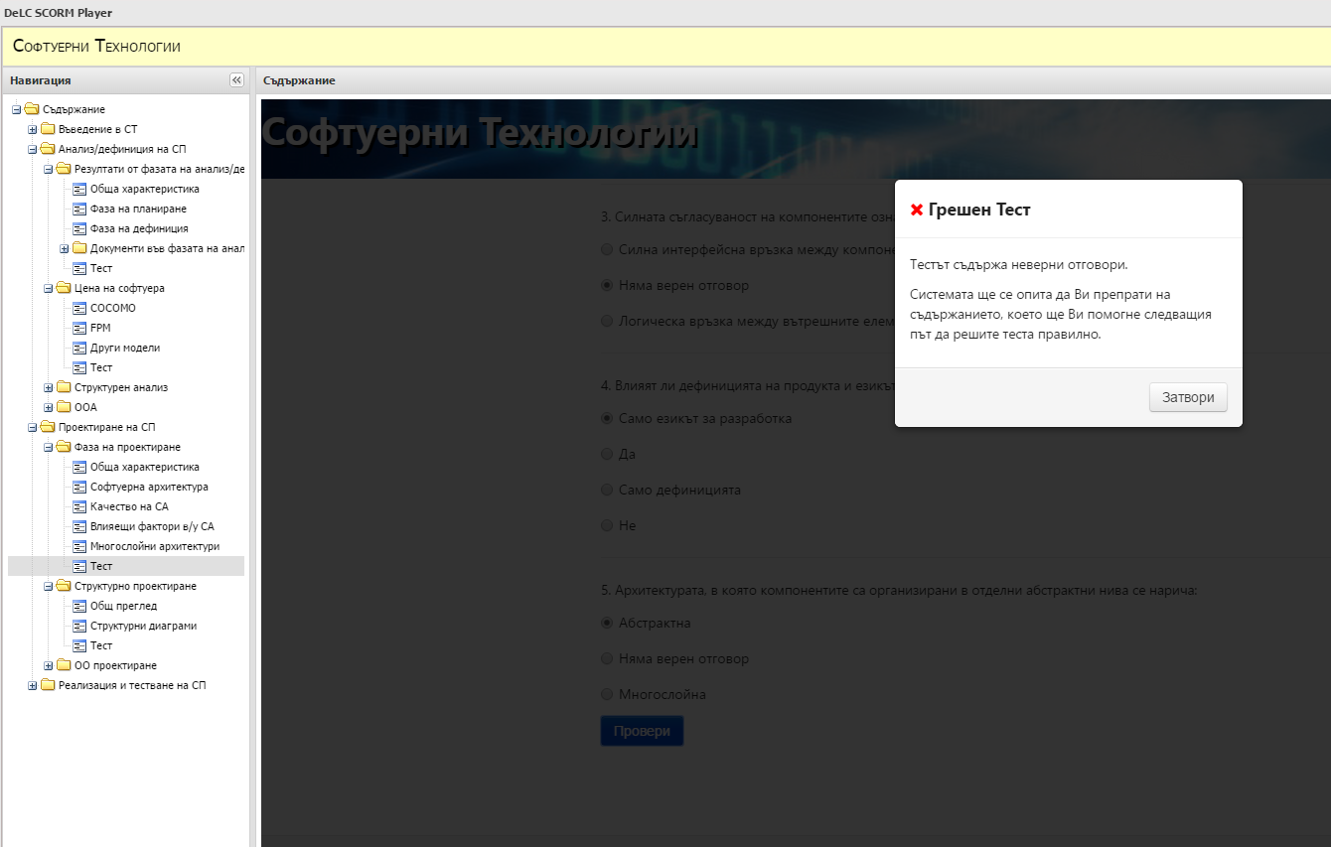
E-textbook in SE

Slide 11
How we use e-textbook in Software Engineering education
SEMESTER WORK according to the education plan
We have 30 hours lectures – face to face education, we use JCSE lecture materials
20 hours exercises – UML examples
100 hours self-study –except referenced literature students have to pass the e-textbook in SE
Feedback: students feedback, SCORM feedback
EXAM – final points are sum of:
Exam in UML – practical exam;
Final test over the lecture materials;
Passing of the e-textbook give the students additional points to the final result.

Slide 12
SCORM Feedback
Students progress in e-textbook in real time

Slide 13
SCORM Feedback
Overall Statistics for All Users
Activity ID | Title | Attempts | Users Attempted | Average Attempts
ACT-405926 | Многослойни архитектури | 188 | 130 | 1,4462
ACT-319886 | Въведение | 292 | 199 | 1,4673
ACT-53607 | Системни тестове | 176 | 119 | 1,479
ACT-80387 | Влияещи фактори в/у СА | 199 | 128 | 1,5547
ACT-470479 | Activity диаграми | 236 | 150 | 1,5733
ACT-307755 | Интегр. тестове | 188 | 119 | 1,5798
ACT-509617 | Валид. тестове | 178 | 112 | 1,5893
ACT-979258 | Sequence диаграми | 237 | 148 | 1,6014
ACT-156169 | Валидационни тестове | 182 | 112 | 1,625
ACT-763070 | Динамичен модел | 231 | 132 | 1,75
ACT-431728 | Статичен модел | 256 | 145 | 1,7655
ACT-241207 | Дърво на решенията | 271 | 152 | 1,7829
ACT-673369 | Общ преглед | 330 | 185 | 1,7838
ACT-186866 | Пример за спецификация на изискванията | 228 | 127 | 1,7953
ACT-130755 | Use case | 279 | 155 | 1,8
ACT-487185 | Таблица на решенията | 270 | 150 | 1,8
ACT-687593 | Въведение | 377 | 202 | 1,8663
ACT-808281 | Крайни автомати(State transition) | 282 | 151 | 1,8675
ACT-259305 | Въведение | 379 | 202 | 1,8762
ACT-519927 | Обща характеристика | 342 | 182 | 1,8791
ACT-867276 | Правила | 312 | 166 | 1,8795
ACT-50435 | Структурни диаграми | 267 | 139 | 1,9209
ACT-613241 | Проект на разработката | 263 | 135 | 1,9481
ACT-411436 | Проект на архитектурата | 267 | 137 | 1,9489
ACT-828976 | Collaboration диаграми | 294 | 150 | 1,96
ACT-90810 | Обща характеристика | 373 | 190 | 1,9632
ACT-291771 | Модел на продукта | 249 | 125 | 1,992
ACT-590636 | Качество на СА | 269 | 135 | 1,9926
ACT-732699 | Софтуерна архитектура | 285 | 143 | 1,993
ACT-614991 | Речник | 265 | 132 | 2,0076
ACT-701674 | FPM | 300 | 149 | 2,0134
ACT-86344 | Миниспецификации | 292 | 145 | 2,0138
ACT-338073 | Тест | 717 | 181 | 3,9613
ACT-971339 | Тест | 832 | 203 | 4,0985
ACT-683133 | Спецификация на изискванията | 633 | 146 | 4,3356
ACT-402361 | Речници от данни и усъвършенстване на данните | 676 | 153 | 4,4183
ACT-864274 | Тест | 1029 | 197 | 5,2234
ACT-294616 | Тест | 1188 | 193 | 6,1554
ACT-737424 | Итеративен модел | 1432 | 207 | 6,9179
ACT-889116 | Водопаден модел | 1655 | 224 | 7,3884
ACT-998208 | Модели на СП | 1801 | 237 | 7,5992
ACT-823647 | Тест | 3122 | 234 | 13,3419
Stats for user with ID 234
Actrivity ID | Title | Attempts
ACT-813274 | Прототипиране | 1
ACT-860078 | Въведение | 1
ACT-971339 | Тест | 1
ACT-259305 | Въведение | 1
ACT-848767 | Речници от данни | 1
ACT-687593 | Въведение | 1
ACT-867276 | Правила | 1
ACT-319886 | Въведение | 1
ACT-68501 | Тест | 1
ACT-979258 | Sequence диаграми | 1
ACT-828976 | Collaboration диаграми | 1
ACT-627485 | Обща характеристика | 1
ACT-683133 | Спецификация на изискванията | 1
ACT-701674 | FPM | 1
ACT-256247 | Други модели | 1
ACT-93136 | Осн. принципи | 1
ACT-402361 | Речници от данни и усъвършенстване на данните | 1
ACT-294616 | Тест | 1
ACT-320917 | ERD | 2
ACT-864274 | Тест | 2
ACT-Introduction | Въведение | 3
ACT-540318 | Cleanroom engineering | 3
ACT-155499 | Спирален модел | 3
ACT-132900 | Фонтанен модел | 3
ACT-149332 | Тест | 3
ACT-132198 | V- модел | 4
ACT-223897 | Тест | 4
ACT-983256 | Въведение | 4
ACT-726476 | Тест | 4
ACT-737424 | Итеративен модел | 6
ACT-255427 | Тест | 8
ACT-271201 | COCOMO | 9
ACT-998208 | Модели на СП | 10
ACT-823647 | Тест | 25
ACT-889116 | Водопаден модел | 27

Slide 14
CONCLUSIONS
The e-textbook is very useful for students and for lecturers;
The additional points that gives the e-textbook to final exam motivate the students to read it;
The SCORM feedback:
is a good way to track the student progress at any time of the semester;
helps the lecturer to evaluate the quality of the e-content
SCORM increases the personalization of the learning process.

Slide 15
Thank you for your attention!

